Slide 1
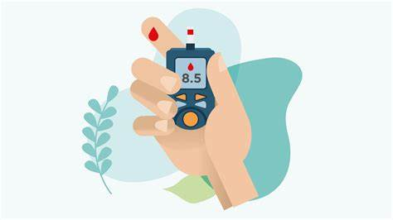
Recommendation system for diabetic patient to recommend life style

Slide 2
Outlines
Introduction
Problem description
System Design
Dataset description
Conclusion & Future Work
Lessons
Implementation & Results

Slide 3
Introduction [\-
Diabetes is a chronic disease with the potential to cause a worldwide health care crisis. According to International Diabetes Federation 537million people are living with diabetes across the whole world in 2021. By 2035, this will be increased to 784 million. Diabetes mellitus or simply diabetes is a disease caused due to the increase level of blood glucose. Various traditional methods, based on physical and chemical tests, are available for diagnosing diabetes. However, early prediction of diabetes is quite challenging task for medical practitioners due to complex interdependence on various factors as diabetes affects human organs such as kidney, eye, heart, nerves, foot etc. Data science methods have the potential to benefit other scientific fields by shedding new light on common questions. One such task is to help make predictions on medical data and another one is to make personalized recommendations for the patients. Machine learning is an emerging scientific field in data science dealing with the ways in which machines learn from experience. The aim of this project is to develop a system which, mainly, has two functions. The first one is to perform early prediction of diabetes for a patient with a higher accuracy by combining the results of different machine learning techniques. And the second function is to recommend personal or customized healthy meals considering a specified diet plan in order to take a step away from having diabetes, in case of the IGT* or to control the disease, in case the patient, currently, has diabetes type2. In order to implement this, we used different machine learning techniques including: This project aims to predict diabetes via three different supervised machine learning methods including: SVM, Logistic regression, ANN. This project also aims to propose an effective technique for earlier detection of the diabetes disease. *Impaired glucose tolerance (IGT) is a category of higher-than-normal blood glucose, but below the threshold for diagnosing diabetes.

Slide 4
Problem description
Diabetes is a disease that occurs when your blood glucose level is too high. Blood sugar is the main source of energy and comes from the food you eat. Insulin, a hormone made by the pancreas, and insulin serves as a key to open our cells, to allow the glucose to enter and allow us to use glucose for energy. But with diabetes, this system does not work. Diabetes contributes to high blood pressure and is linked with high cholesterol which significantly increases the risk of heart attacks, strokes, eye problems and blindness. kidneys are another organ that is at particular risk of damage as a result of. Diabetes effect on the skin is usually a result of its effect on the nerves and circulation which can lead to dry skin; slow healing of cuts, burns and wounds, fungal and bacterial infection and the loss of feeling in the foot. Due to increase in diabetes cases worldwide and due to the overgrowing negligence of people towards this issue, the medical industry is in need for predicting diabetes to control and create awareness among the patients to avoid fatal health issues or even death in the years to come .

Slide 5
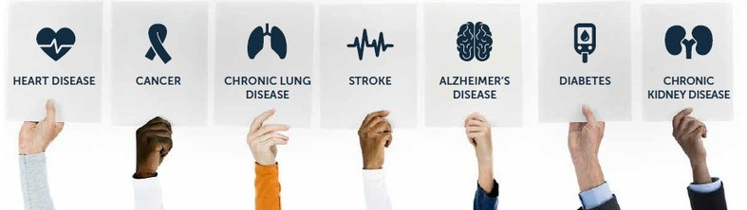
Why?
Chronic
Diseases Treatment

Slide 6
System Design

Slide 7
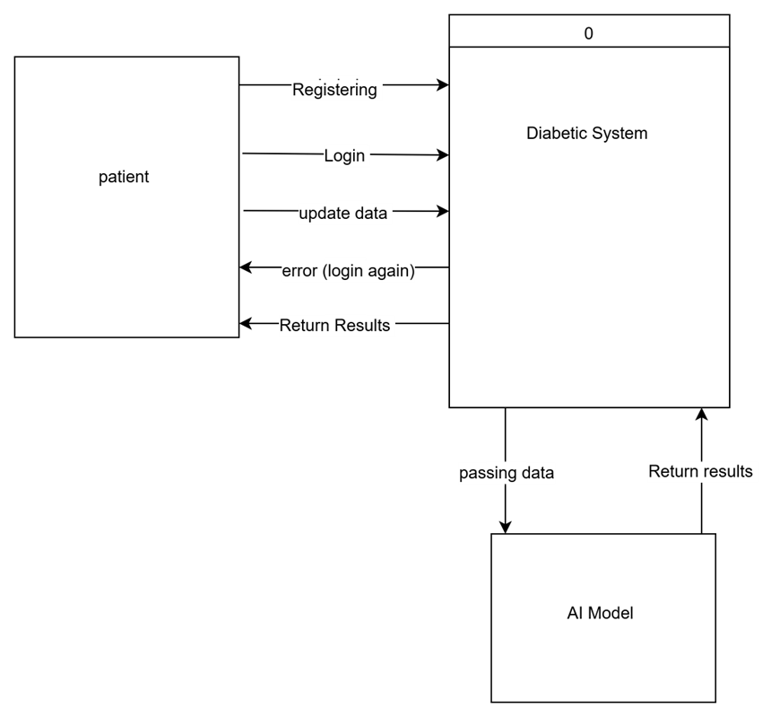
Context diagram

Slide 8
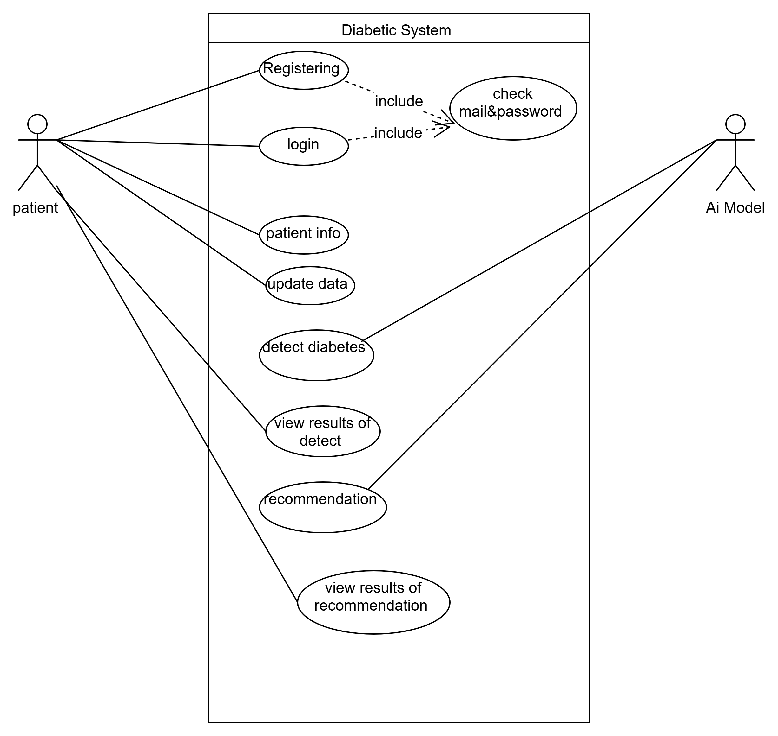
Use case

Slide 9
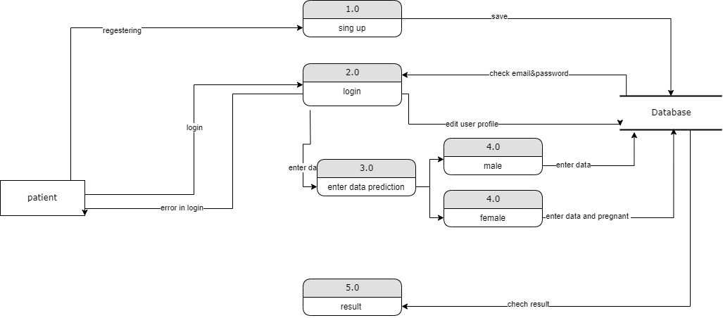
Data Flow Diagram (DFD)

Slide 10
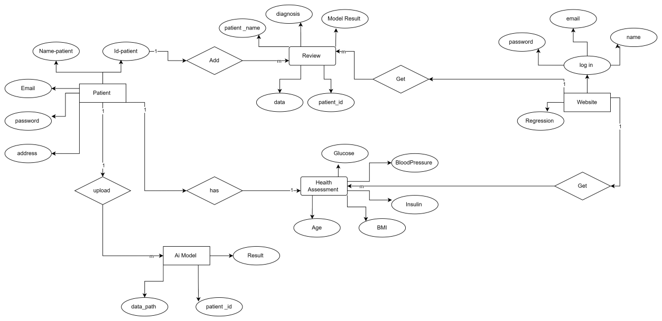
Entity Relationship Diagram (ERD)

Slide 11
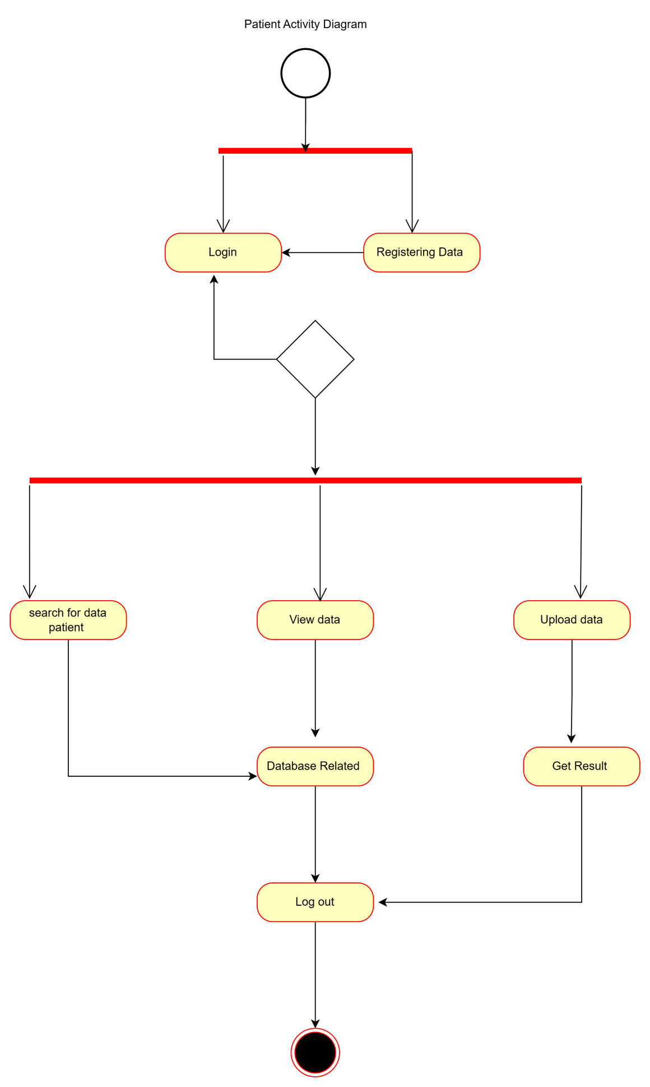
UML Activity Diagram

Slide 12
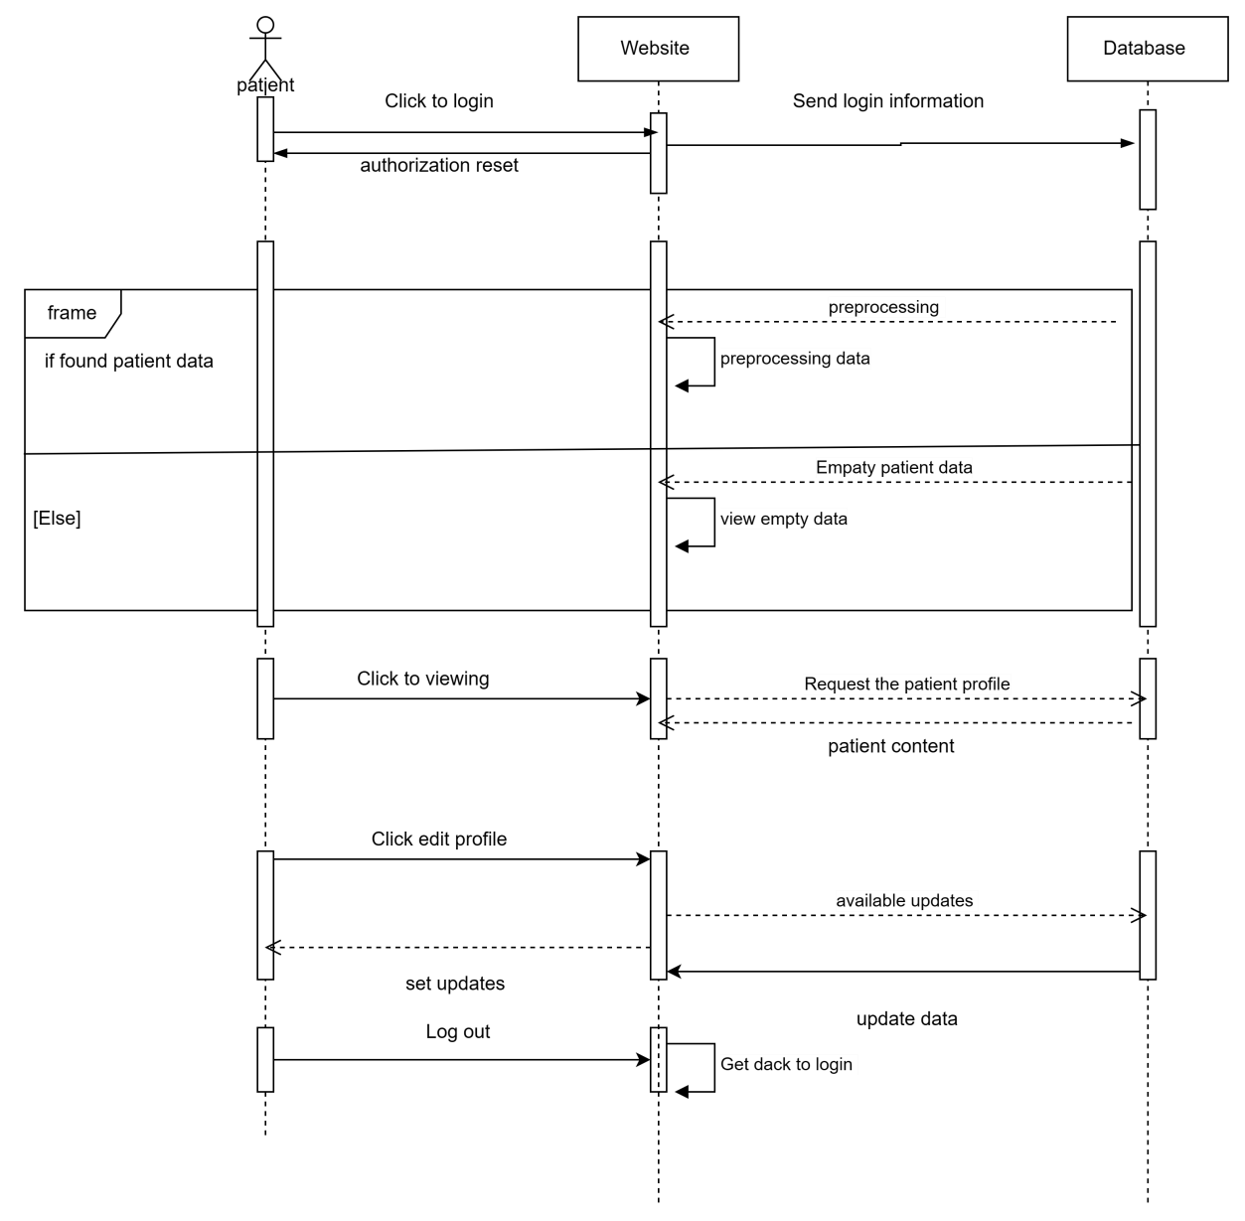
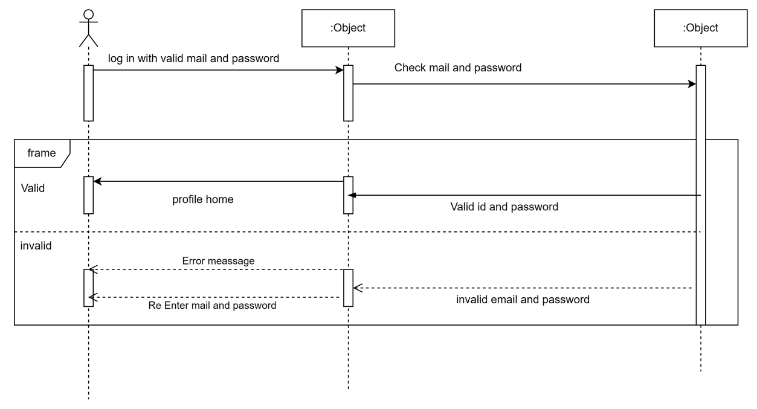
UML Sequence Diagram

Slide 13
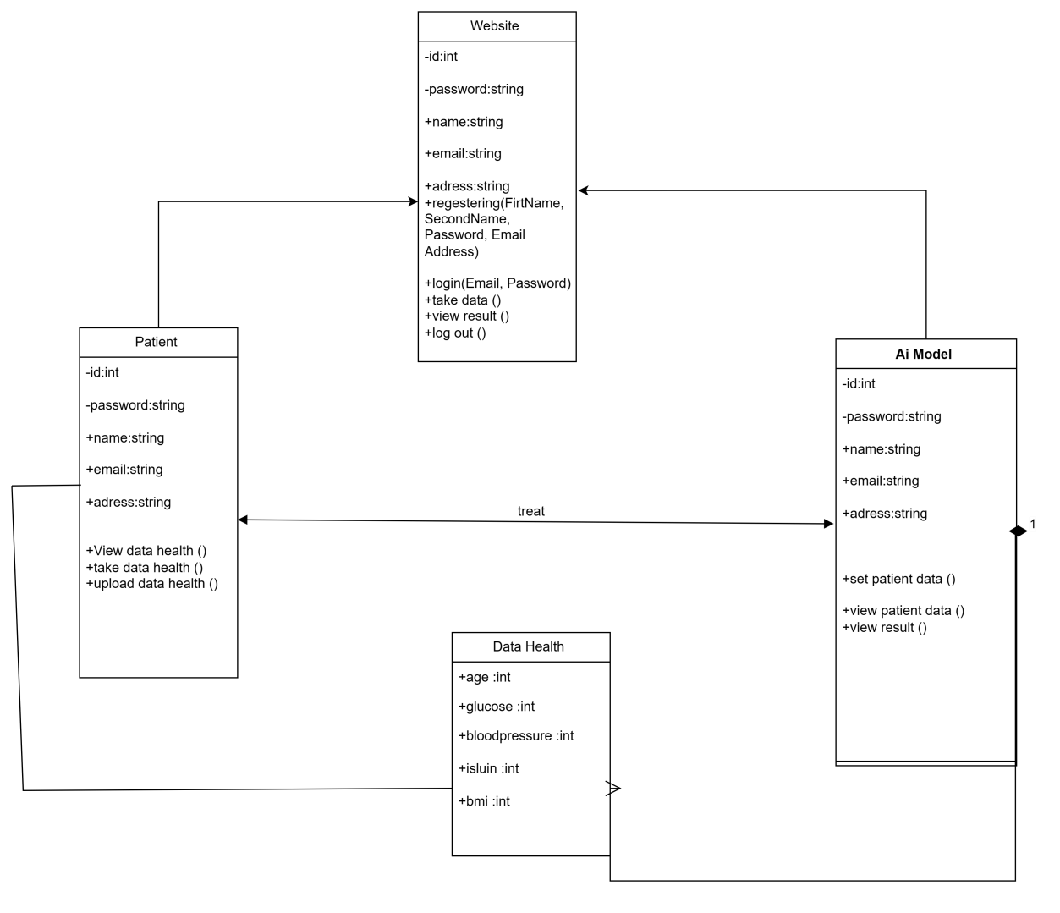
UML Class Diagram

Slide 14
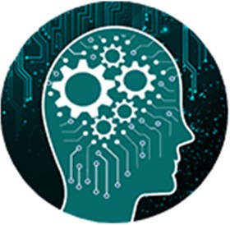
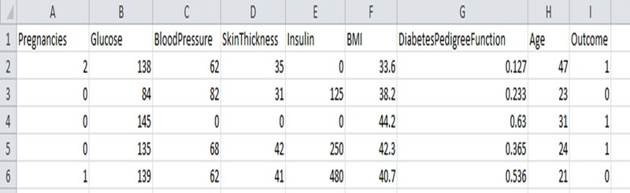
Dataset Description
The data is gathered from UCI repository which is named as Pima Indian Diabetes Dataset. The dataset have many attributes of 2768 patients.

Slide 15
Apply Machine Learning
When data has been ready we apply Machine Learning Technique. We use different classification and ensemble techniques, to predict diabetes

Slide 16
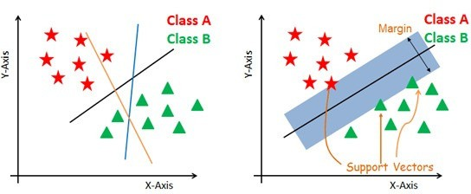
1) Support Vector Machine

Slide 17
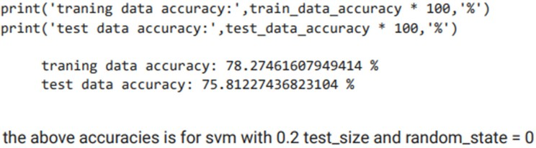
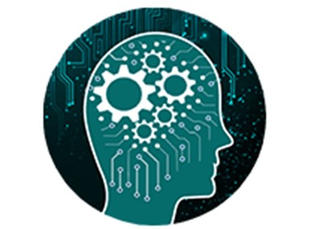
accuracy is not the best here as the margin is very small.
Accuracy of SVM

Slide 18
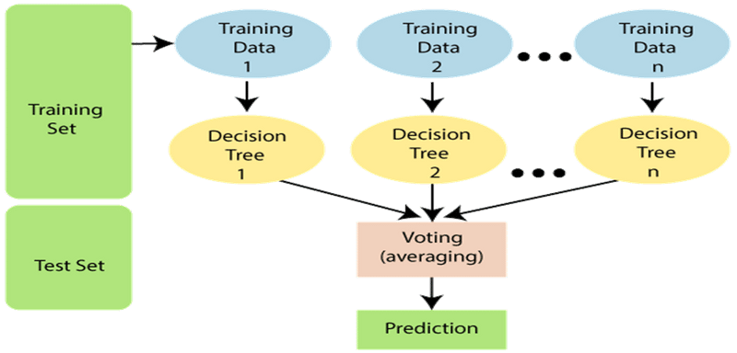
2) Random Forest

Slide 19
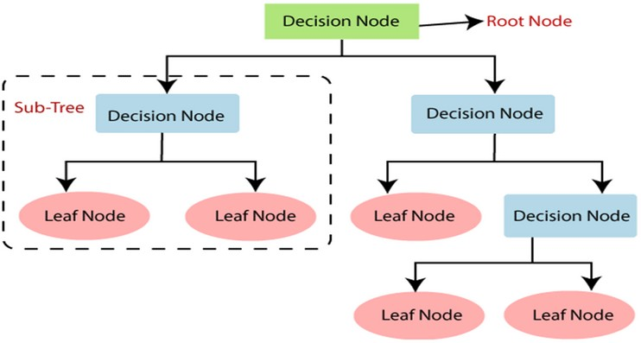
Decision Tree

Slide 20
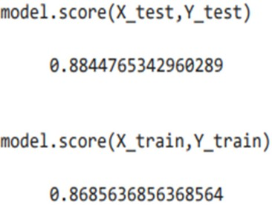
Accuracy of Random Forest

Slide 21
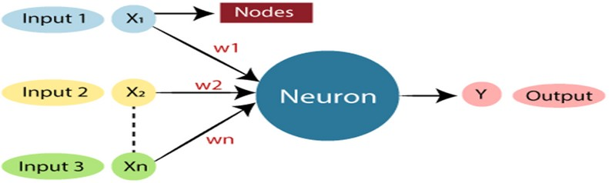
3) Neural Network Model

Slide 22
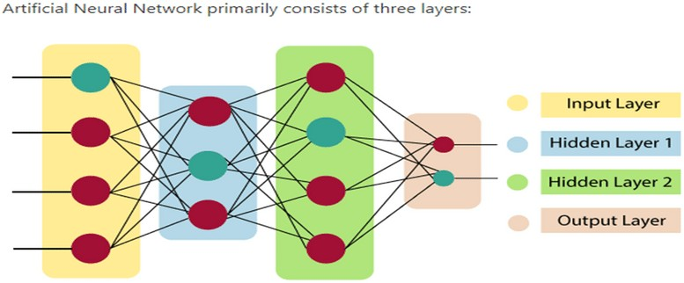
3) Neural Network Model

Slide 23
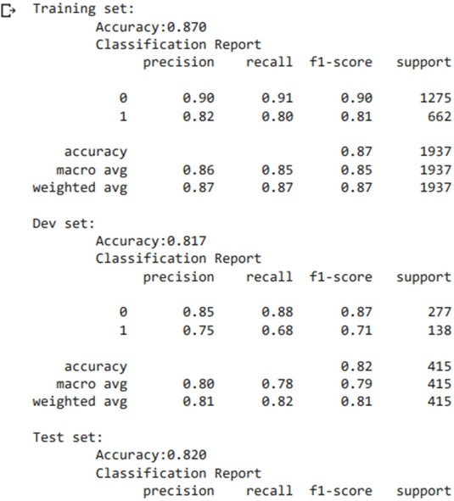
Accuracy of model

Slide 24




EXPERIMENTAL RESULTS
Different steps were taken.
The proposed approach uses different classification and ensemble methods and implemented using python.
These methods are standard Machine Learning methods used to obtain the best accuracy from data.
Finally, we see that random forest classifier achieves the best result compared to others.

Slide 25
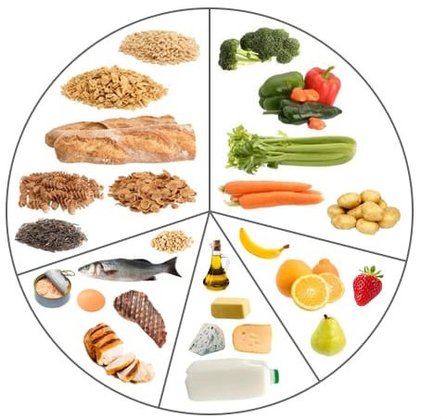
Nutrition Recommender System

Slide 26
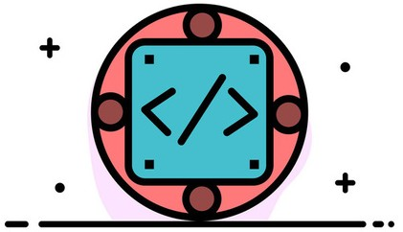
Implementation
Diabetes Prediction Model
Recommendation Model
User Interface

Slide 27
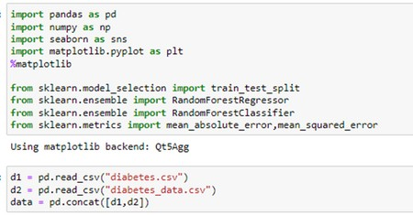
Code_1 (Diabetes_prediction_model)
Import libraries for our model

Slide 28
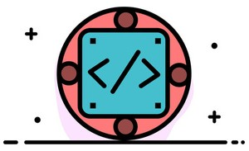
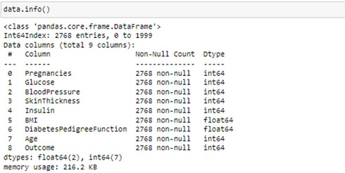
Explore the data

Slide 29
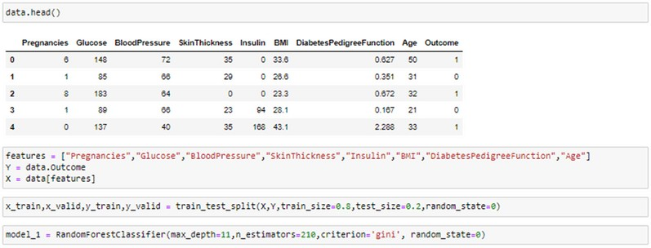
split the data for training and validation

Slide 30
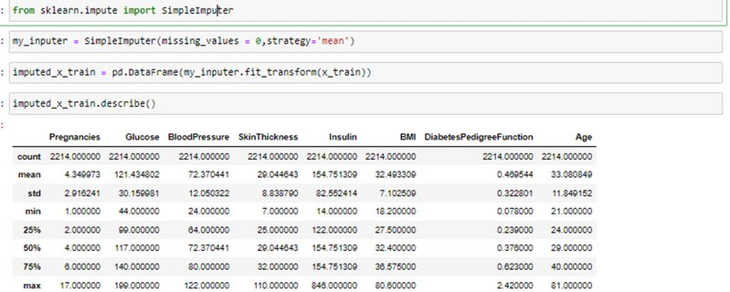
Handling zeros in our data
to improve accuracy

Slide 31
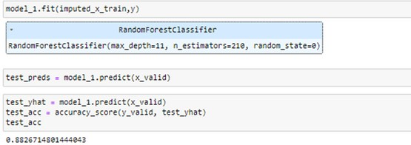
fit the model with data and test accuracy

Slide 32
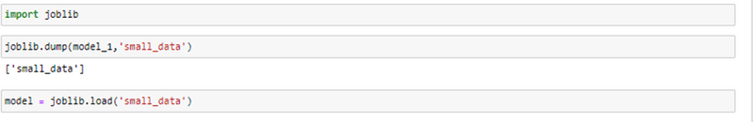
Save the model

Slide 33
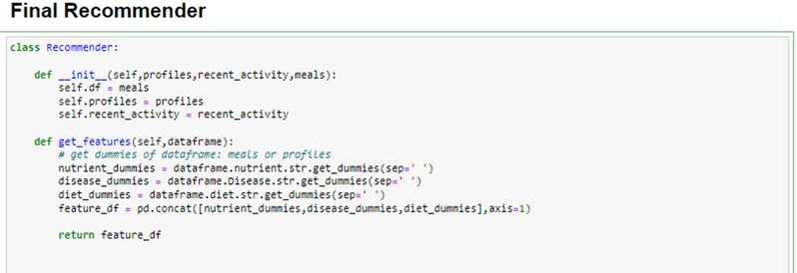
Code_2 (Recommender_model)

Slide 34
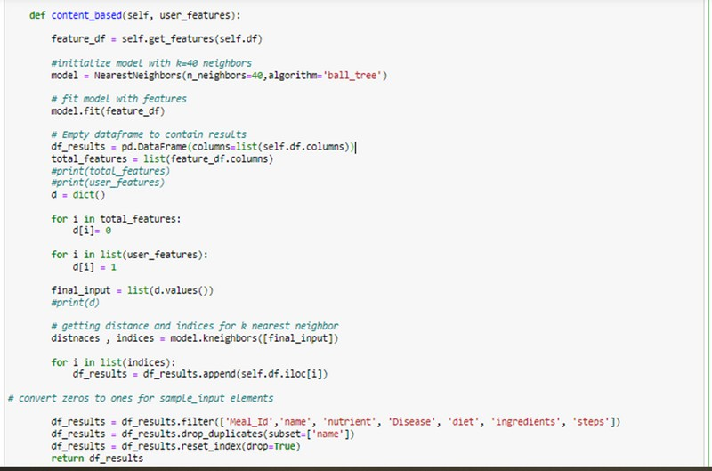

Slide 35
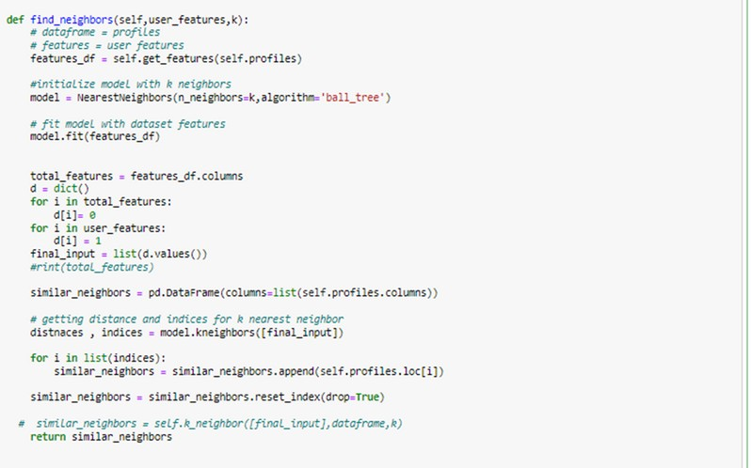

Slide 37
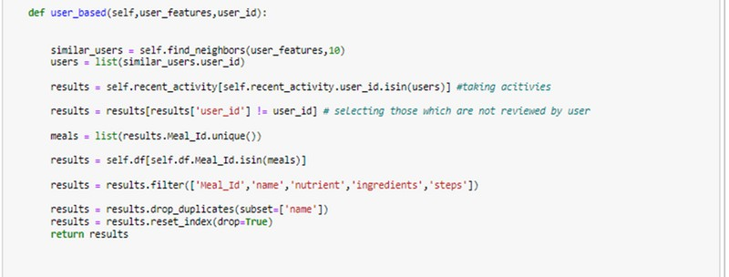

Slide 38
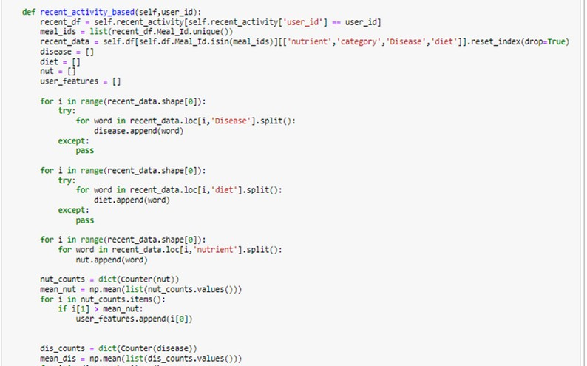

Slide 39
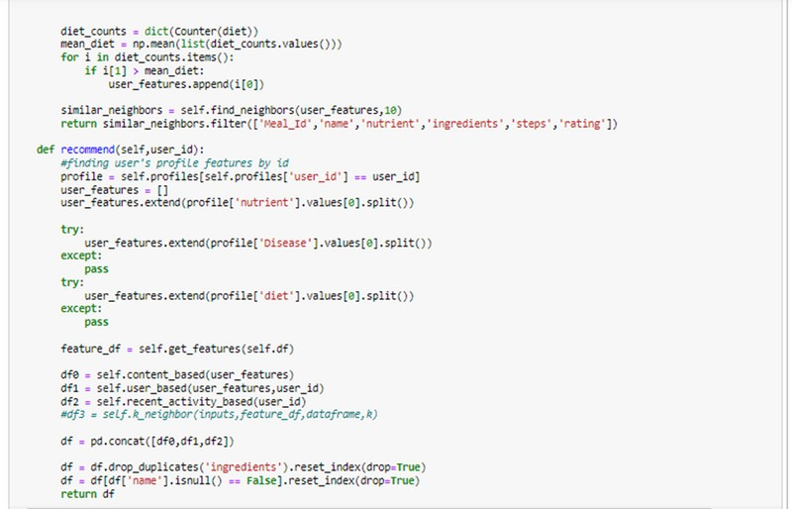

Slide 40
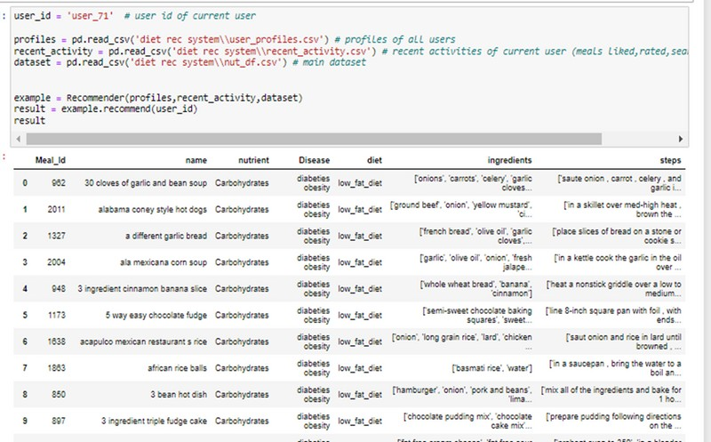

Slide 41
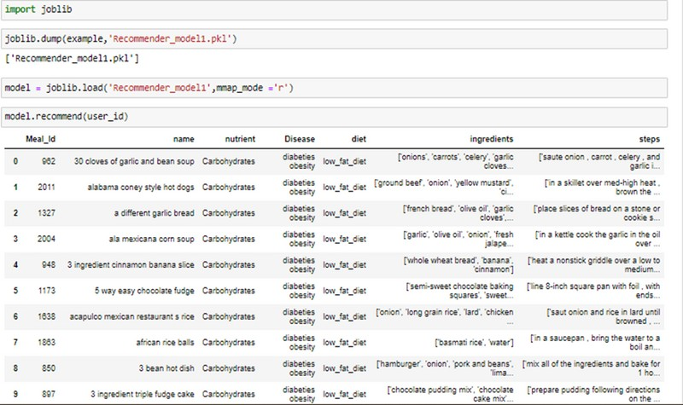
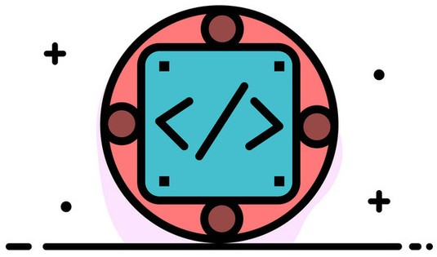
save the model
and check for
user_71

Slide 42
Stream Lit
User Interface

Slide 43
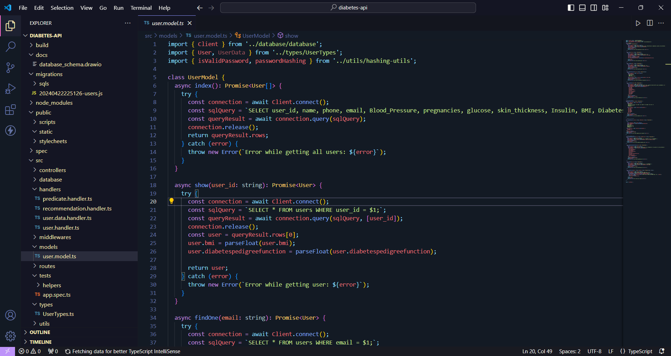
Connection to Database

Slide 44
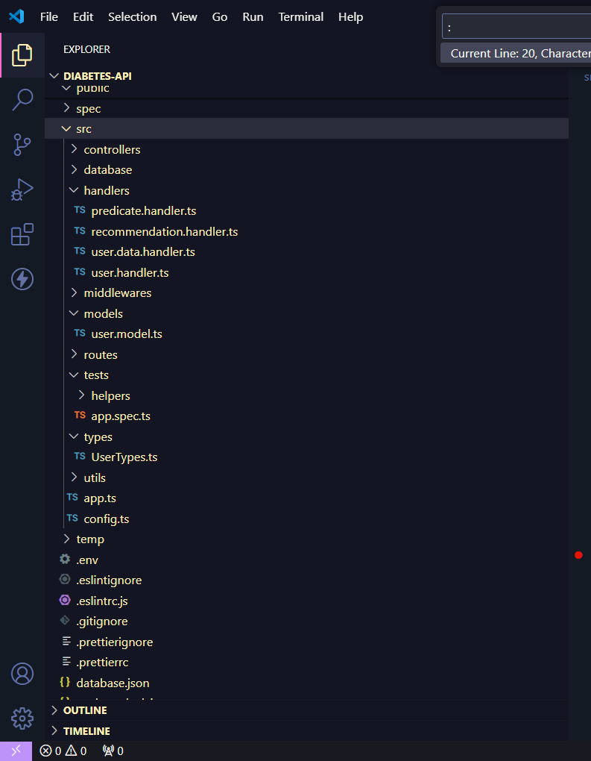
Summarization for backend
Node.js and Express.js: Utilized for strong and fast backend development environment.
Project Organization: Multiple modules (Controllers, Models, Routes, and Middleware) used for organized application management.

Slide 45
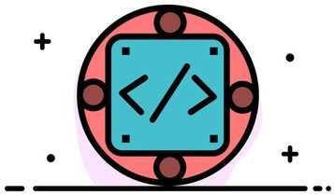
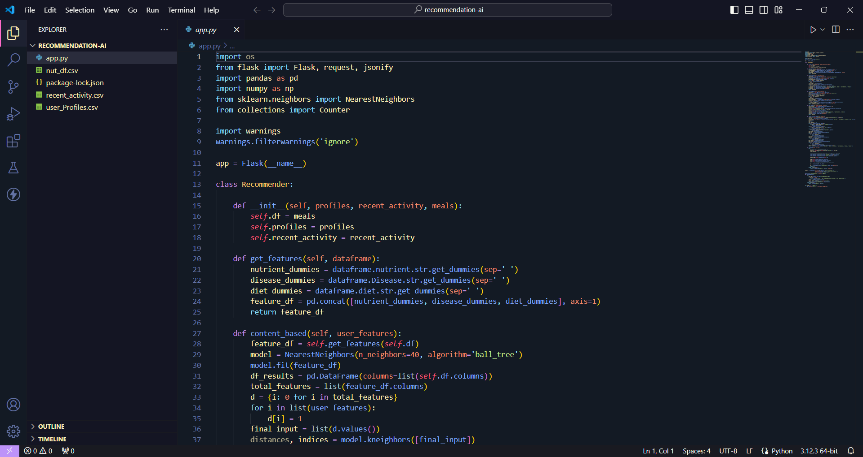
Prediction Model Function
takes user's data
and checks
diabetes

Slide 46
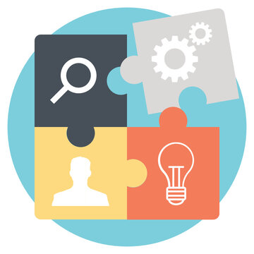
Conclusion

Slide 47
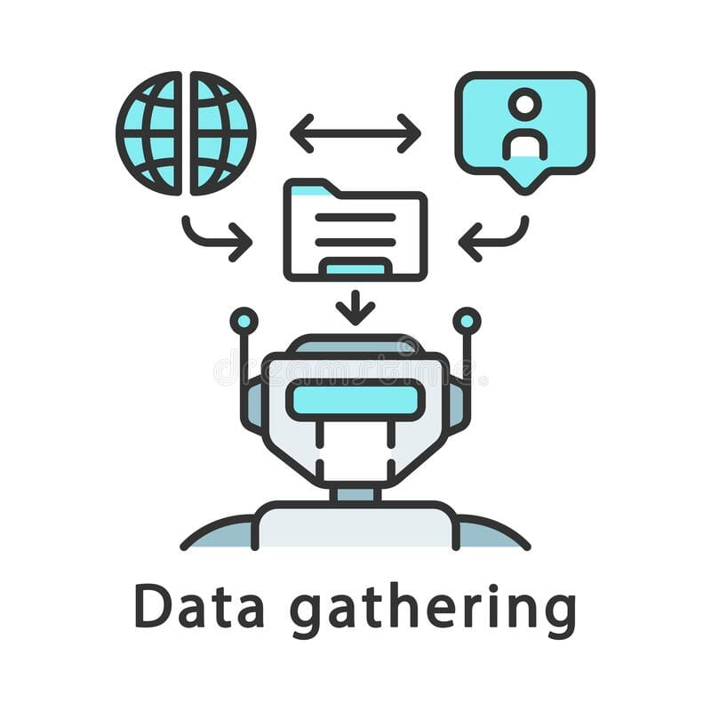
Conclusion

Slide 48
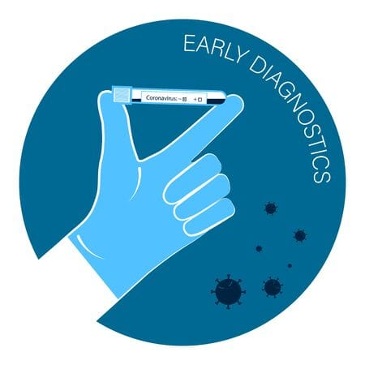
Conclusion
Constructing Early detection machine model

Slide 49
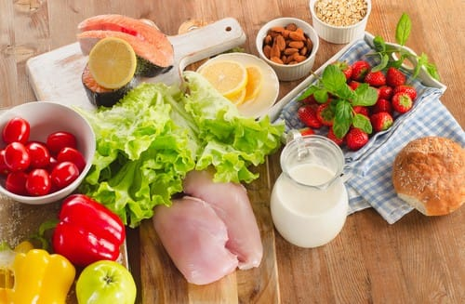
Conclusion
Collecting data about Disease-specific nutrition instructions

Slide 50
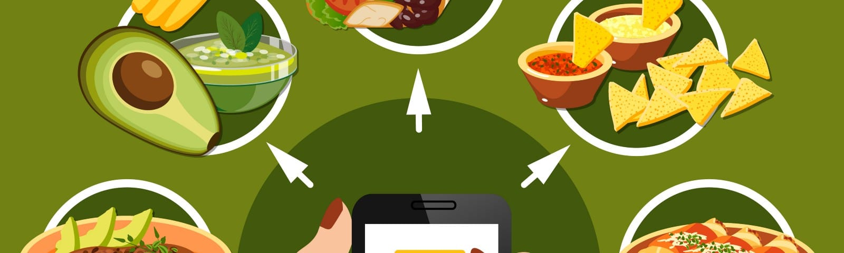
Conclusion
constructing healthy food Recommendation System

Slide 51
Future Work
Make the app more practical and available for public users this can be done by :
The designed system with the used machine learning algorithms can be used to predict or diagnose
other Chronic Diseases
Work can be extended and improved for the automation of diabetes monitoring

Slide 52
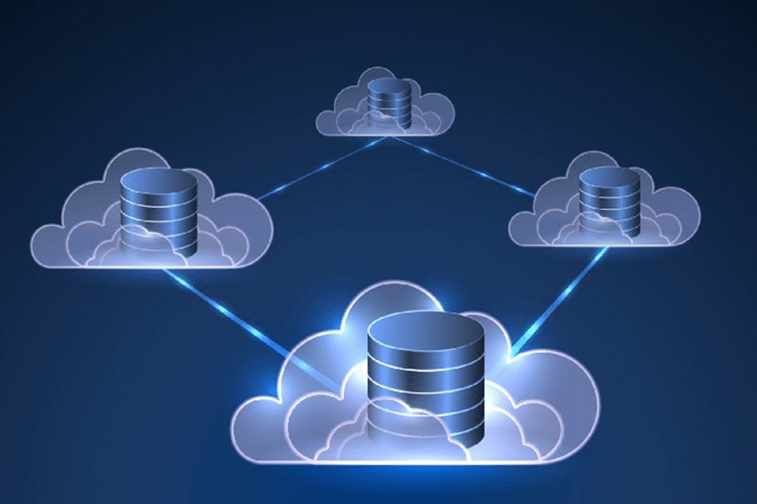
Future Work
Convert static database to dynamic using cloud storage instead.

Slide 53
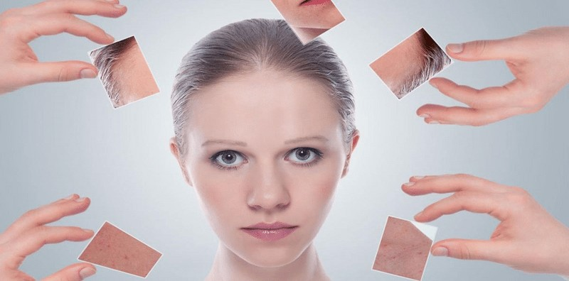
Future Work
Find approximate ranges for measured parameters like skin thickness and genetic function to suit usage of general users.

Slide 54

Future Work
Apply community features to the application such as groups.

Slide 55





Lessons
Technical Experience
Learned
Team Work
Technical Writing
Research
Critical Thinking

Slide 56
Thank You
“Time and health are two precious assets that we don’t recognize and appreciate until they have been depleted.”
Denis Waitley

